Slide 1

Intro to Time Series
What is a time series?

Slide 2
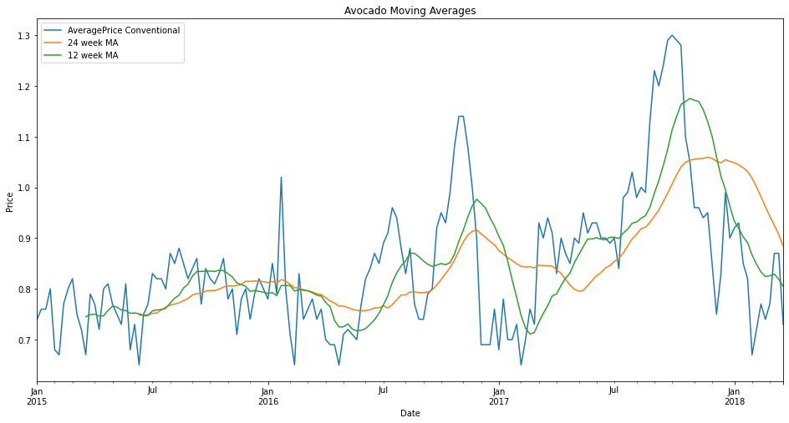
Welcome!
Terminology
Applications
Forecasting
Data
Jim Frank
DSI Alumni
Data Scientist / Evangelist
@Galvanize

Slide 3
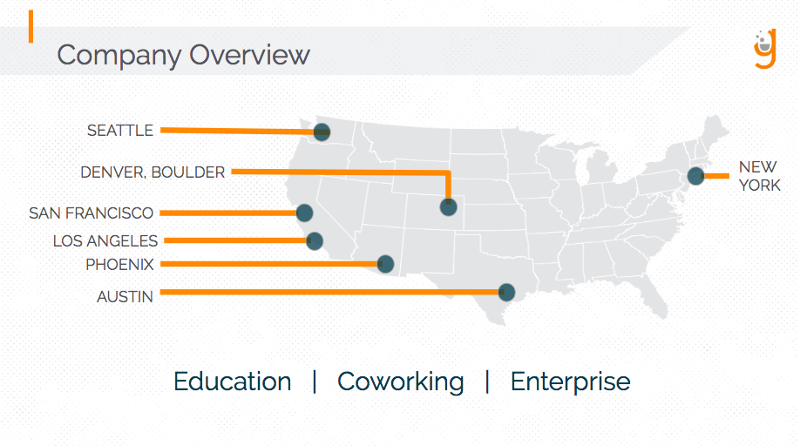
What is Galvanize?
Galvanize.com
Education
Co-Working
Events
Enterprise
Free Intro to Python & More
https://www.galvanize.com/data-science/prep

Slide 4
What this workshop is
This is a friendly introduction to Time Series. No previous experience is expected. Knowing some Python will make it a little easier.
By sticking through this workshop, you will learn something new today.
Avocado time series walk-through in a Google colab notebook
Keep learning after this workshop! Additional resources will be shared.

Slide 5

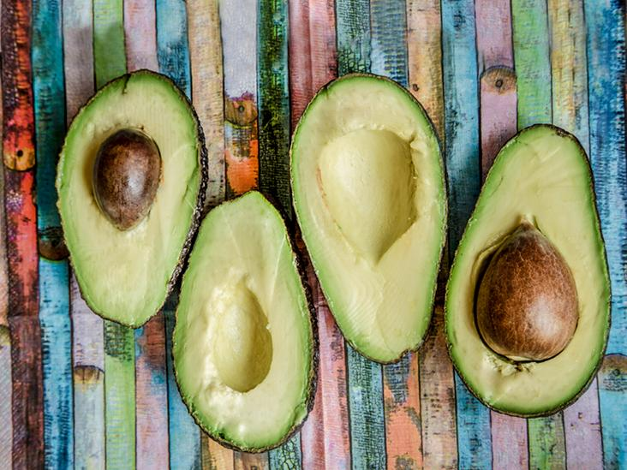
Avocados can teach you about time series
Notes:
https://bit.ly/30lO9Cq

Slide 6
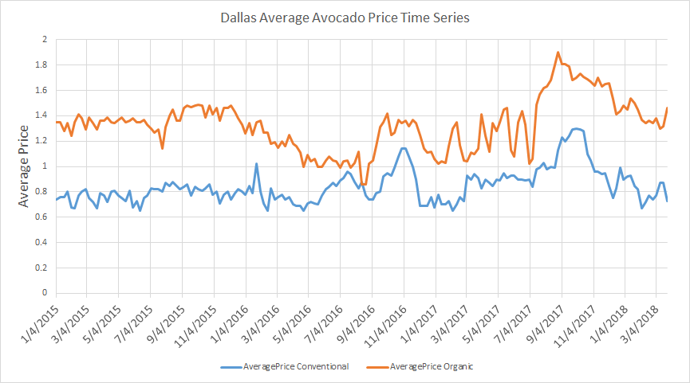
Univariate Avocado T.S. // time and one variable
Notes:
https://bit.ly/30lO9Cq

Slide 7
What is a time series?
At a foundational level, it is a variable measured over time
example: A continuous variable like temperature
A constant time interval
example: “hourly temperature”
Counts of discrete events during a selected interval is common
example: Number of product sales per day

Slide 8
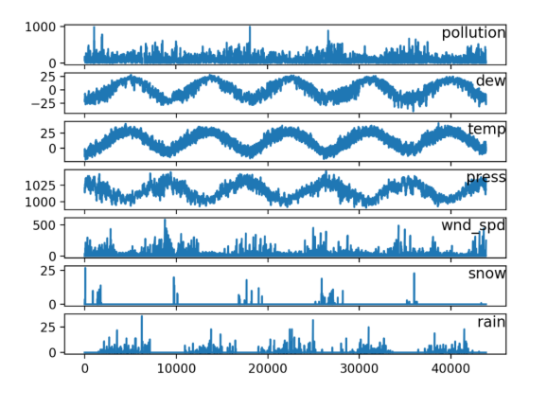
Univariate and Multivariate
If there is a correlation between variables, the additional data may help make better forecasts.
Source: Machine Learning Mastery

Slide 9
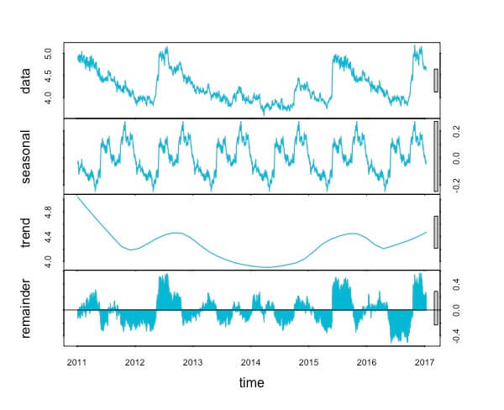
Basic terms for time series
Level
Trend
Seasonality
Noise // Remainder
Decomposition
Source algorithmia

Slide 10
Additive and Multiplicative
It is helpful to understand how models are built so you can better explain the time series you are investigating.
Additive Model:
Time series = t (trend) + s (seasonality) + n (noise)
Multiplicative Model:
Time series = t (trend) * s (seasonality) * n (noise)

Slide 11
Where are time series used?
Large amounts of time series data is being generated in a variety of fields. This is a small set of examples. There are too many data sources to list them all!
Avocados:
Weekly average price
Weekly total volume
Environment Science:
Weather
Lava flows
Astronomy
Social Science:
Demographics
Movement rates
Healthcare:
Virus infections
Finance:
Commodity prices
Stock market prices
Currency exchange
Cryptocurrency
Sales and Marketing:
TV viewership rates
Product sales rates

Slide 12
Better understanding of what happened
Anomaly detection
business monitoring
fraud detection
medical anomalies
cyber attack detection
Temporal pattern detection
Event impact analysis

Slide 13
Moving Average
Lookback over a time window of your choice, then take the average.

Slide 14
Time Series Forecasting
I’ll share some about these 3 methods. Of course there are more forecasting methods available.
ARIMA moving average forecasting
Facebook prophet
Amazon Sagemaker DeepAR

Slide 15
ARIMA Forecasting
ARIMA moving average forecasting
Auto Regressive (AR): Means that past time points could have a certain degree of current and future time observations. The ARIMA model takes into account lagged observations in order to come up with forecast observations. A weight is added to past observations however, the weight can vary on how recent the past observations are. The more recent, the more weight is added to the most recent past observation.
Integrated (I): If there are consistent trends in the movement of past prices, it is most likely to be non-stationary meaning that seasonality persists in past movement of prices. Integrated removes the seasonality phase of our dataset in case there are consistent patterns that show that this is the case. The degree of differencing available in ARIMA models eliminates the seasonality trend issue.
Moving Average (MA): Moving average helps remove the effect of random movements of avocado prices in our case. If there was an extraordinary event that led to a surge in avocado prices, moving average will help us "smooth" things up and our time series model will not be prone to these fluctuations. (source : this kaggle writeup)

Slide 16
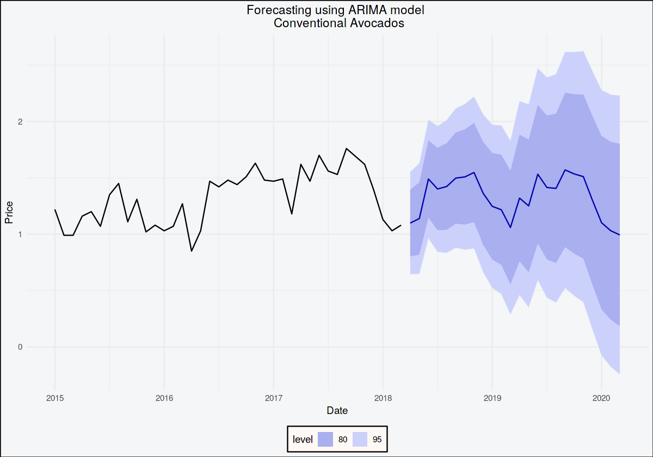
Time Series Forecasting
2. We will cover Facebook Prophet forecasting in the notebook. (link)
ARIMA forecast figure source (link)

Slide 17
Amazon Sagemaker DeepAR (link)
“A supervised learning algorithm for forecasting scalar (one-dimensional) time series using recurrent neural networks (RNN).”
“In many applications, however, you have many similar time series across a set of cross-sectional units. For example, you might have time series groupings for demand for different products, server loads, and requests for webpages. For this type of application, you can benefit from training a single model jointly over all of the time series.”
“Each target time series can be optionally associated with a vector of static (time-independent) categorical features”

Slide 18
Forecasting Comparison
ARIMA moving average forecasting
Commonly used historically
Facebook prophet
Univariate forecasting
Runs faster than ARIMA
Easily implemented seasonality & holidays
Amazon Sagemaker DeepAR
Improved accuracy across sets of related time series
Time independent categorical features

Slide 19
Question break before avocado walkthrough
We’ll be using an online Data Science Coding Environment called Colab
To follow along later on, make sure you can access the notebook
A modern Web Browser (Like chrome)
A Google account (Colab is a tool made by Google)
Let’s dive in with Python! (slides link)
https://colab.research.google.com/drive/14YWL9j_MVbDJ6LCCQvtq1R9jOLvBAttn?usp=sharing

Slide 20
Avocado Dataset From Kaggle
Description sourced from the Kaggle data page
“This data was downloaded from the Hass Avocado Board website in May of 2018 & compiled into a single CSV.”
“The table below represents weekly 2018 retail scan data for National retail volume (units) and price. Retail scan data comes directly from retailers’ cash registers based on actual retail sales of Hass avocados. Starting in 2013, the table below reflects an expanded, multi-outlet retail data set. Multi-outlet reporting includes an aggregation of the following channels: grocery, mass, club, drug, dollar and military. The Average Price (of avocados) in the table reflects a per unit (per avocado) cost, even when multiple units (avocados) are sold in bags.”
Some relevant data columns are:
Date (2015 - 2018) measured weekly
AveragePrice
Type (conventional or organic)
Region
Total Volume

Slide 21
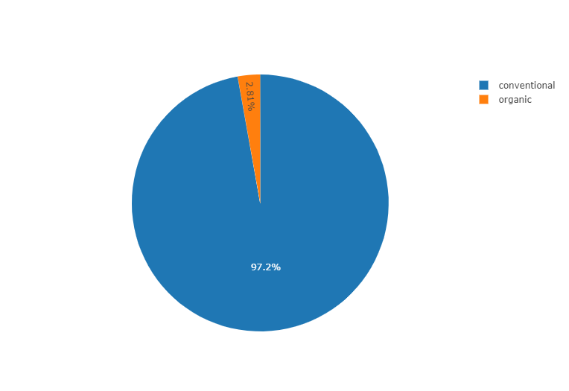
EDA (exploratory data analysis)
EDA from this wonderful notebook (link)

Slide 22
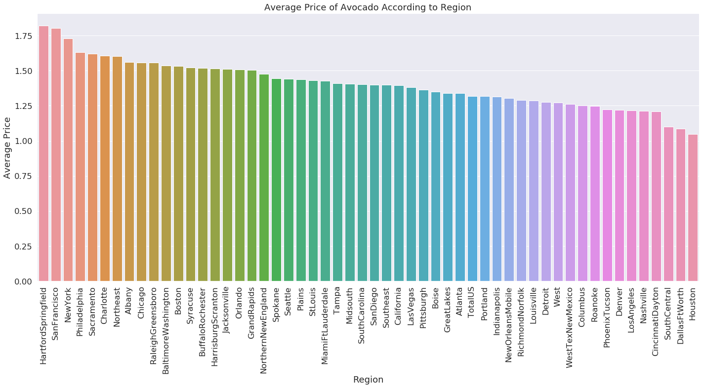

Slide 23
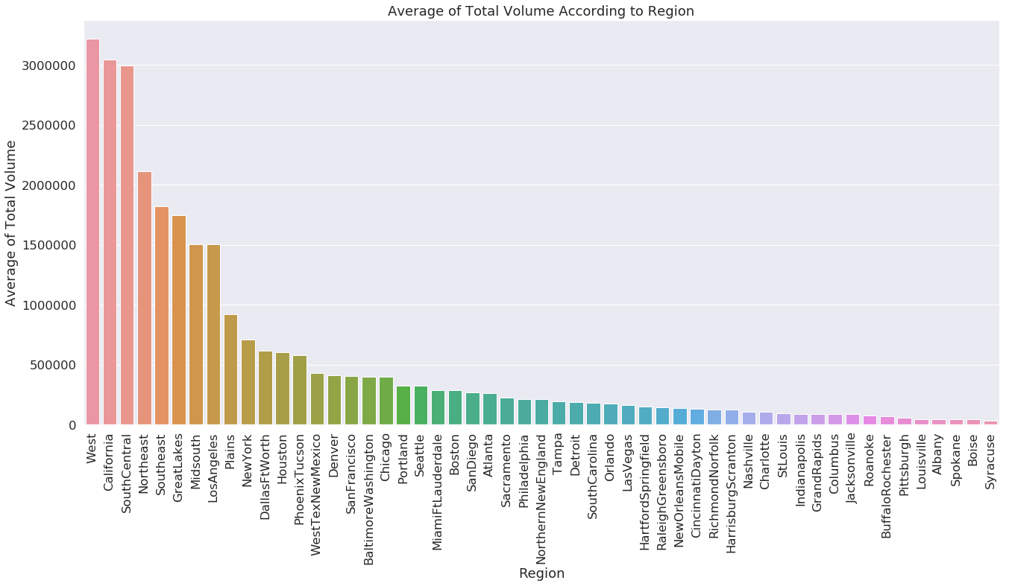

Slide 24
Coding Expectations for yourself
It’s OK if something doesn’t make sense. Learning to program is complicated!
Getting errors are awesome. They’re trying to tell you what to fix. Don’t panic!
You don’t need to memorize everything. Try to remember high level concepts so you can google when you need it.
Be awesome to yourself and others! Everyone has a different background and learning style.
You CAN do this!

Slide 25
Links & Resources
Free Galvanize Data Science Python Prep Course
The tech community is wonderful! People love sharing their knowledge.
https://algorithmia.com/blog/introduction-to-time-series
Intro to time series with ARIMA
https://www.anodot.com/learning-center/time-series-metrics/
https://www.analyticssteps.com/blogs/introduction-time-series-analysis-time-series-forecasting-machine-learning-methods-models

